Slide 1


Saif Al-Dilaimi
Software Entwickler
saif.aldilaimi@icloud.com
Der Pooling Layer

Slide 2

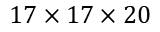
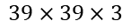
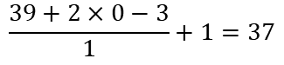
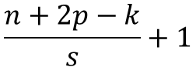
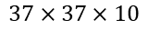
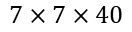
Keras Convolutional Neural Network
Dense(1960)
1
Filter=10
Kernel_size=(3,3)
Stride=(1,1)
Padding=0 or Valid
Filter=20
Kernel_size=(5,5)
Stride=(2,2)
Padding=0 or Valid
Filter=40
Kernel_size=(5,5)
Stride=(2,2)
Padding=0 or Valid
2
1
…
2
$$39×39×3$$
$$37×37×10$$
$$17×17×20$$
$$7×7×40$$
1960
$$\frac{n+2p−k}{s}+1$$
Je Tiefer im Netz je kleiner die Dimension und je größer die Filter
$$\frac{39+2×0−3}{1}+1=37$$

Slide 3
Keras Pooling Layer
model.add(MaxPooling2D(...))
MaxPooling2D(...)
Pool_size=(2, 2)
strides=None
X
MaxPooling2D(pool_size=(2,2))

Slide 4
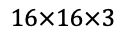
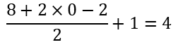
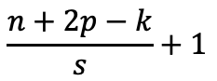
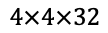
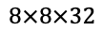
Keras Pooling Layer
Conv2D(32, kernel_size=(2,2), strides=(2,2))
MaxPooling2D(pool_size=(2,2))
X
$$8×8×32$$
$$4×4×32$$
$$16×16×3$$
32
32
4
8
$$\frac{n+2p−k}{s}+1$$
$$\frac{8+2×0−2}{2}+1=4$$

Slide 5
Keras Pooling Layer

Slide 6
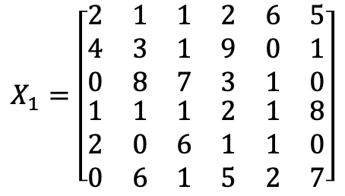
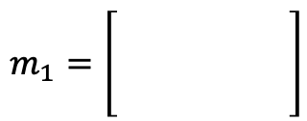
Keras Max Pooling Operation
Pool_size = (2,2); Stride = (2,2)
$$X_{1}=\left[\begin{matrix}\begin{matrix}2 & 1 \\ 4 & 3 \\ 0 & 8\end{matrix} & \begin{matrix}1 & 2 \\ 1 & 9 \\ 7 & 3\end{matrix} & \begin{matrix}6 & 5 \\ 0 & 1 \\ 1 & 0\end{matrix} \\ \begin{matrix}1 & 1 \\ 2 & 0 \\ 0 & 6\end{matrix} & \begin{matrix}1 & 2 \\ 6 & 1 \\ 1 & 5\end{matrix} & \begin{matrix}1 & 8 \\ 1 & 0 \\ 2 & 7\end{matrix}\end{matrix}\right]$$
$$m_{1}=\left[\begin{matrix}\begin{matrix} & \\ & \\ & \end{matrix} & \begin{matrix} \\ \\ \end{matrix}\end{matrix}\right]$$

Slide 7
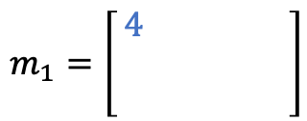
Keras Max Pooling Operation
Pool_size = (2,2); Stride = (2,2)
$$X_{1}=\left[\begin{matrix}\begin{matrix}2 & 1 \\ 4 & 3 \\ 0 & 8\end{matrix} & \begin{matrix}1 & 2 \\ 1 & 9 \\ 7 & 3\end{matrix} & \begin{matrix}6 & 5 \\ 0 & 1 \\ 1 & 0\end{matrix} \\ \begin{matrix}1 & 1 \\ 2 & 0 \\ 0 & 6\end{matrix} & \begin{matrix}1 & 2 \\ 6 & 1 \\ 1 & 5\end{matrix} & \begin{matrix}1 & 8 \\ 1 & 0 \\ 2 & 7\end{matrix}\end{matrix}\right]$$
$$m_{1}=\left[\begin{matrix}\begin{matrix}4 & \\ & \\ & \end{matrix} & \begin{matrix} \\ \\ \end{matrix}\end{matrix}\right]$$

Slide 8
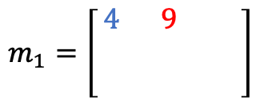
Keras Max Pooling Operation
Pool_size = (2,2); Stride = (2,2)
$$X_{1}=\left[\begin{matrix}\begin{matrix}2 & 1 \\ 4 & 3 \\ 0 & 8\end{matrix} & \begin{matrix}1 & 2 \\ 1 & 9 \\ 7 & 3\end{matrix} & \begin{matrix}6 & 5 \\ 0 & 1 \\ 1 & 0\end{matrix} \\ \begin{matrix}1 & 1 \\ 2 & 0 \\ 0 & 6\end{matrix} & \begin{matrix}1 & 2 \\ 6 & 1 \\ 1 & 5\end{matrix} & \begin{matrix}1 & 8 \\ 1 & 0 \\ 2 & 7\end{matrix}\end{matrix}\right]$$
$$m_{1}=\left[\begin{matrix}\begin{matrix}4 & 9 \\ & \\ & \end{matrix} & \begin{matrix} \\ \\ \end{matrix}\end{matrix}\right]$$

Slide 9
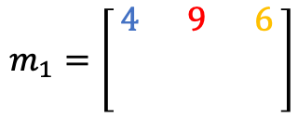
Keras Max Pooling Operation
Pool_size = (2,2); Stride = (2,2)
$$X_{1}=\left[\begin{matrix}\begin{matrix}2 & 1 \\ 4 & 3 \\ 0 & 8\end{matrix} & \begin{matrix}1 & 2 \\ 1 & 9 \\ 7 & 3\end{matrix} & \begin{matrix}6 & 5 \\ 0 & 1 \\ 1 & 0\end{matrix} \\ \begin{matrix}1 & 1 \\ 2 & 0 \\ 0 & 6\end{matrix} & \begin{matrix}1 & 2 \\ 6 & 1 \\ 1 & 5\end{matrix} & \begin{matrix}1 & 8 \\ 1 & 0 \\ 2 & 7\end{matrix}\end{matrix}\right]$$
$$m_{1}=\left[\begin{matrix}\begin{matrix}4 & 9 \\ & \\ & \end{matrix} & \begin{matrix}6 \\ \\ \end{matrix}\end{matrix}\right]$$

Slide 10
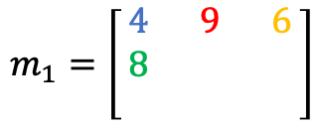
Keras Max Pooling Operation
Pool_size = (2,2); Stride = (2,2)
$$X_{1}=\left[\begin{matrix}\begin{matrix}2 & 1 \\ 4 & 3 \\ 0 & 8\end{matrix} & \begin{matrix}1 & 2 \\ 1 & 9 \\ 7 & 3\end{matrix} & \begin{matrix}6 & 5 \\ 0 & 1 \\ 1 & 0\end{matrix} \\ \begin{matrix}1 & 1 \\ 2 & 0 \\ 0 & 6\end{matrix} & \begin{matrix}1 & 2 \\ 6 & 1 \\ 1 & 5\end{matrix} & \begin{matrix}1 & 8 \\ 1 & 0 \\ 2 & 7\end{matrix}\end{matrix}\right]$$
$$m_{1}=\left[\begin{matrix}\begin{matrix}4 & 9 \\ 8 & \\ & \end{matrix} & \begin{matrix}6 \\ \\ \end{matrix}\end{matrix}\right]$$

Slide 11
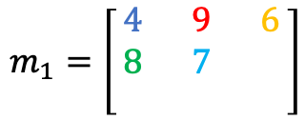
Keras Max Pooling Operation
Pool_size = (2,2); Stride = (2,2)
$$X_{1}=\left[\begin{matrix}\begin{matrix}2 & 1 \\ 4 & 3 \\ 0 & 8\end{matrix} & \begin{matrix}1 & 2 \\ 1 & 9 \\ 7 & 3\end{matrix} & \begin{matrix}6 & 5 \\ 0 & 1 \\ 1 & 0\end{matrix} \\ \begin{matrix}1 & 1 \\ 2 & 0 \\ 0 & 6\end{matrix} & \begin{matrix}1 & 2 \\ 6 & 1 \\ 1 & 5\end{matrix} & \begin{matrix}1 & 8 \\ 1 & 0 \\ 2 & 7\end{matrix}\end{matrix}\right]$$
$$m_{1}=\left[\begin{matrix}\begin{matrix}4 & 9 \\ 8 & 7 \\ & \end{matrix} & \begin{matrix}6 \\ \\ \end{matrix}\end{matrix}\right]$$

Slide 12
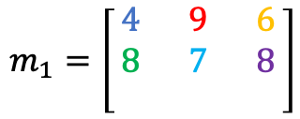
Keras Max Pooling Operation
Pool_size = (2,2); Stride = (2,2)
$$X_{1}=\left[\begin{matrix}\begin{matrix}2 & 1 \\ 4 & 3 \\ 0 & 8\end{matrix} & \begin{matrix}1 & 2 \\ 1 & 9 \\ 7 & 3\end{matrix} & \begin{matrix}6 & 5 \\ 0 & 1 \\ 1 & 0\end{matrix} \\ \begin{matrix}1 & 1 \\ 2 & 0 \\ 0 & 6\end{matrix} & \begin{matrix}1 & 2 \\ 6 & 1 \\ 1 & 5\end{matrix} & \begin{matrix}1 & 8 \\ 1 & 0 \\ 2 & 7\end{matrix}\end{matrix}\right]$$
$$m_{1}=\left[\begin{matrix}\begin{matrix}4 & 9 \\ 8 & 7 \\ & \end{matrix} & \begin{matrix}6 \\ 8 \\ \end{matrix}\end{matrix}\right]$$

Slide 13
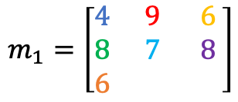
Keras Max Pooling Operation
Pool_size = (2,2); Stride = (2,2)
$$X_{1}=\left[\begin{matrix}\begin{matrix}2 & 1 \\ 4 & 3 \\ 0 & 8\end{matrix} & \begin{matrix}1 & 2 \\ 1 & 9 \\ 7 & 3\end{matrix} & \begin{matrix}6 & 5 \\ 0 & 1 \\ 1 & 0\end{matrix} \\ \begin{matrix}1 & 1 \\ 2 & 0 \\ 0 & 6\end{matrix} & \begin{matrix}1 & 2 \\ 6 & 1 \\ 1 & 5\end{matrix} & \begin{matrix}1 & 8 \\ 1 & 0 \\ 2 & 7\end{matrix}\end{matrix}\right]$$
$$m_{1}=\left[\begin{matrix}\begin{matrix}4 & 9 \\ 8 & 7 \\ 6 & \end{matrix} & \begin{matrix}6 \\ 8 \\ \end{matrix}\end{matrix}\right]$$

Slide 14
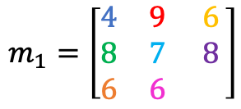
Keras Max Pooling Operation
Pool_size = (2,2); Stride = (2,2)
$$X_{1}=\left[\begin{matrix}\begin{matrix}2 & 1 \\ 4 & 3 \\ 0 & 8\end{matrix} & \begin{matrix}1 & 2 \\ 1 & 9 \\ 7 & 3\end{matrix} & \begin{matrix}6 & 5 \\ 0 & 1 \\ 1 & 0\end{matrix} \\ \begin{matrix}1 & 1 \\ 2 & 0 \\ 0 & 6\end{matrix} & \begin{matrix}1 & 2 \\ 6 & 1 \\ 1 & 5\end{matrix} & \begin{matrix}1 & 8 \\ 1 & 0 \\ 2 & 7\end{matrix}\end{matrix}\right]$$
$$m_{1}=\left[\begin{matrix}\begin{matrix}4 & 9 \\ 8 & 7 \\ 6 & 6\end{matrix} & \begin{matrix}6 \\ 8 \\ \end{matrix}\end{matrix}\right]$$

Slide 15
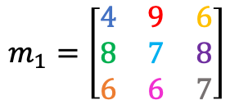
Keras Max Pooling Operation
Pool_size = (2,2); Stride = (2,2)
$$X_{1}=\left[\begin{matrix}\begin{matrix}2 & 1 \\ 4 & 3 \\ 0 & 8\end{matrix} & \begin{matrix}1 & 2 \\ 1 & 9 \\ 7 & 3\end{matrix} & \begin{matrix}6 & 5 \\ 0 & 1 \\ 1 & 0\end{matrix} \\ \begin{matrix}1 & 1 \\ 2 & 0 \\ 0 & 6\end{matrix} & \begin{matrix}1 & 2 \\ 6 & 1 \\ 1 & 5\end{matrix} & \begin{matrix}1 & 8 \\ 1 & 0 \\ 2 & 7\end{matrix}\end{matrix}\right]$$
$$m_{1}=\left[\begin{matrix}\begin{matrix}4 & 9 \\ 8 & 7 \\ 6 & 6\end{matrix} & \begin{matrix}6 \\ 8 \\ 7\end{matrix}\end{matrix}\right]$$

Slide 16


Keras Pooling Operationen
Average Pooling
Global Max Pooling
Global Average Pooling
Input $X :=m x n x c$ Matrix
Output $Y :=m x n x c$ Matrix

Slide 17
Saif Al-Dilaimi
Software Entwickler
saif.aldilaimi@icloud.com
Danke fürs Zuhören!
Gleich geht es weiter mit dem nächsten Thema.

